Slide 1


Slide 2
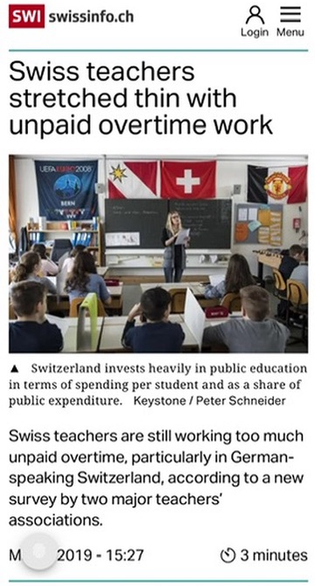
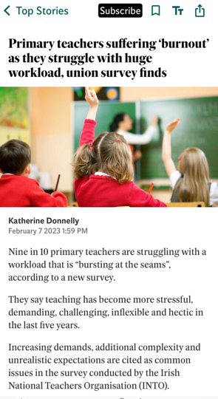

Teachers Overworked

Slide 3
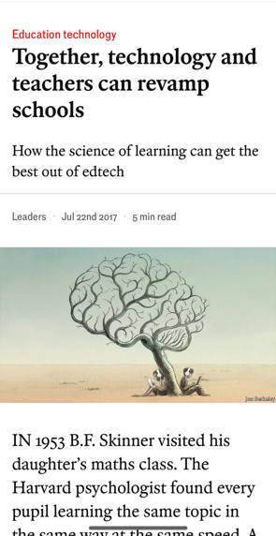

Teachers Overworked

Slide 4
How People Learn
Prior knowledge + New information = New knowledge

Slide 5
How People Learn
Prior knowledge + New information = New knowledge

Slide 6
How People Learn
Prior knowledge + New information = New knowledge
Confused

Slide 7
What if teachers could efficiently track individual student progress and identify knowledge gaps?

Slide 8
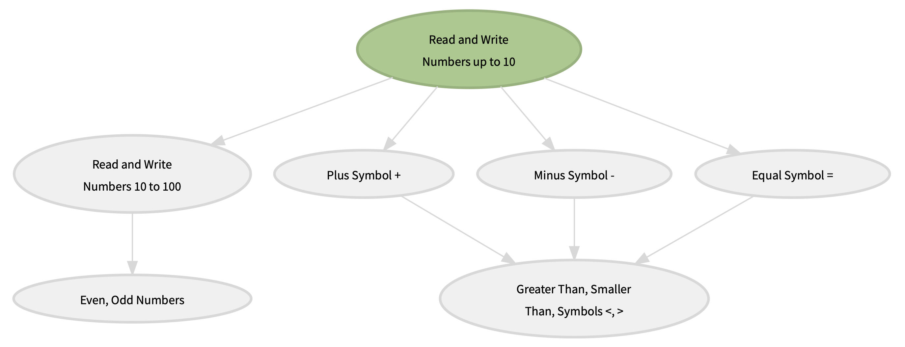
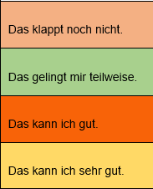
What if teachers could efficiently track individual student progress and identify knowledge gaps?

Slide 9
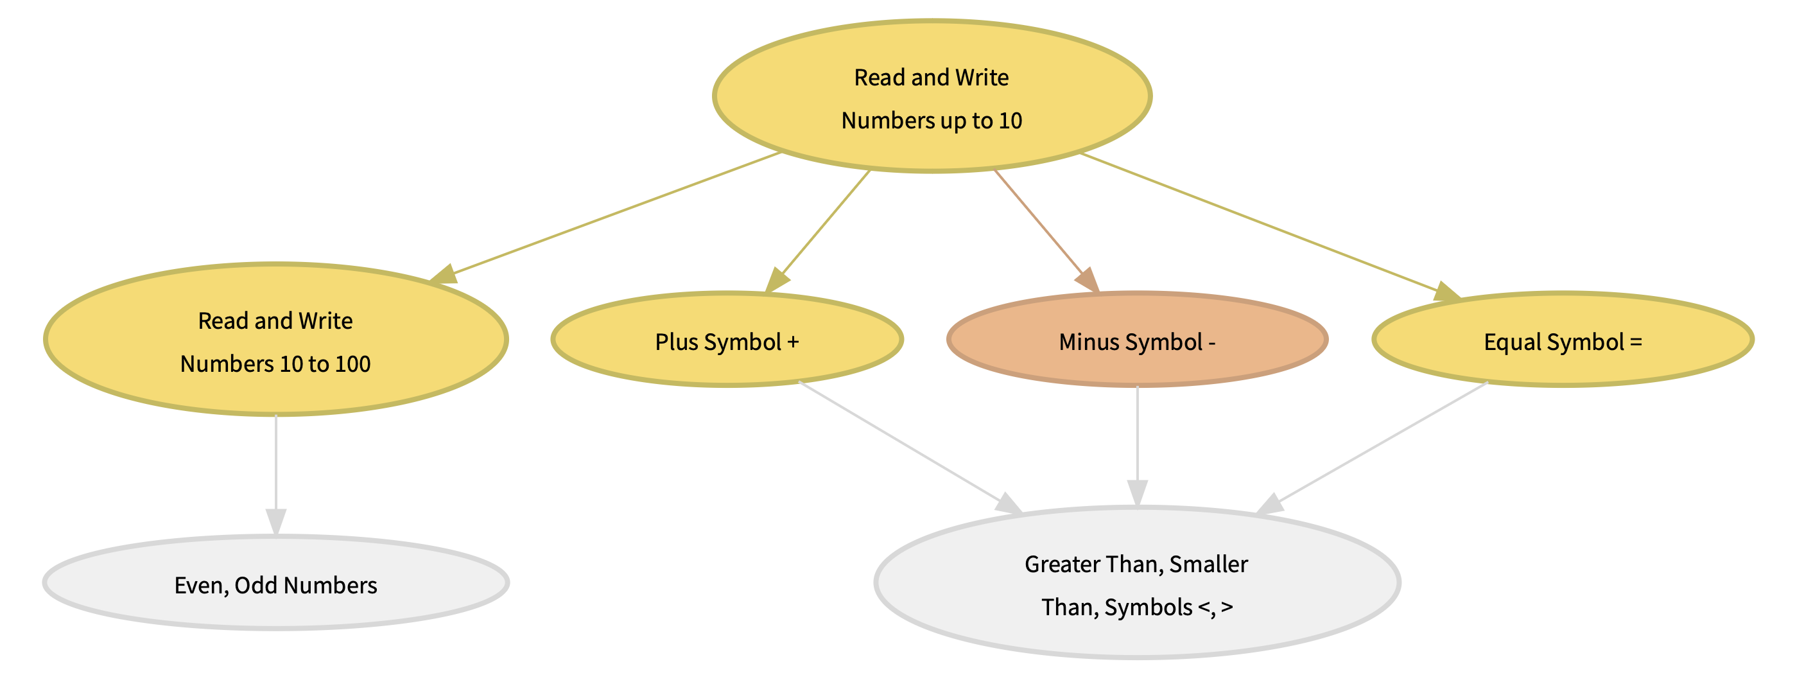
What if teachers could efficiently track individual student progress and identify knowledge gaps?

Slide 10
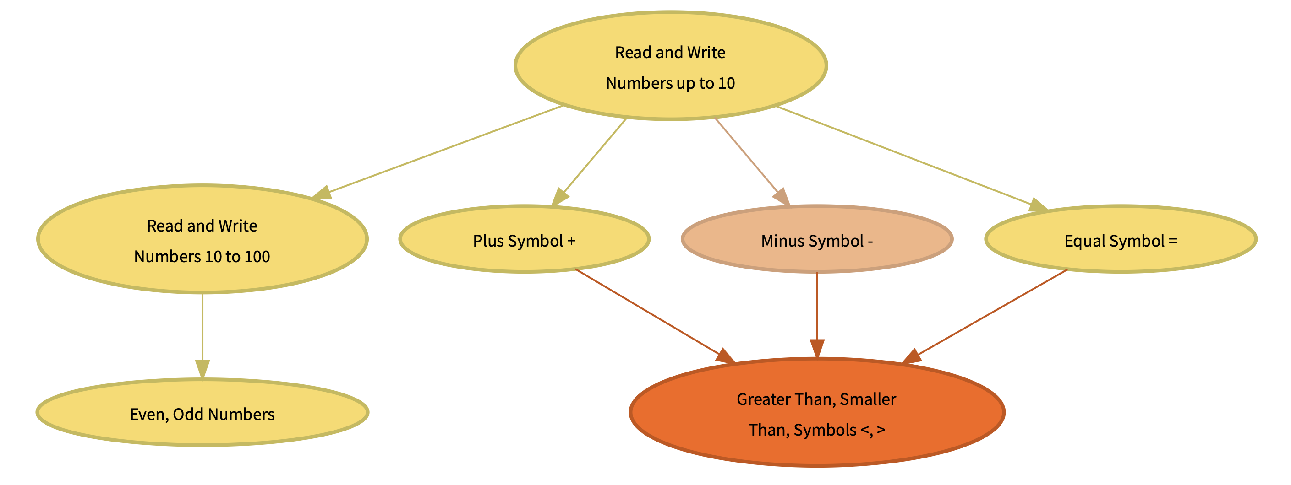
What if teachers could efficiently track individual student progress and identify knowledge gaps?
Weak Point

Slide 11
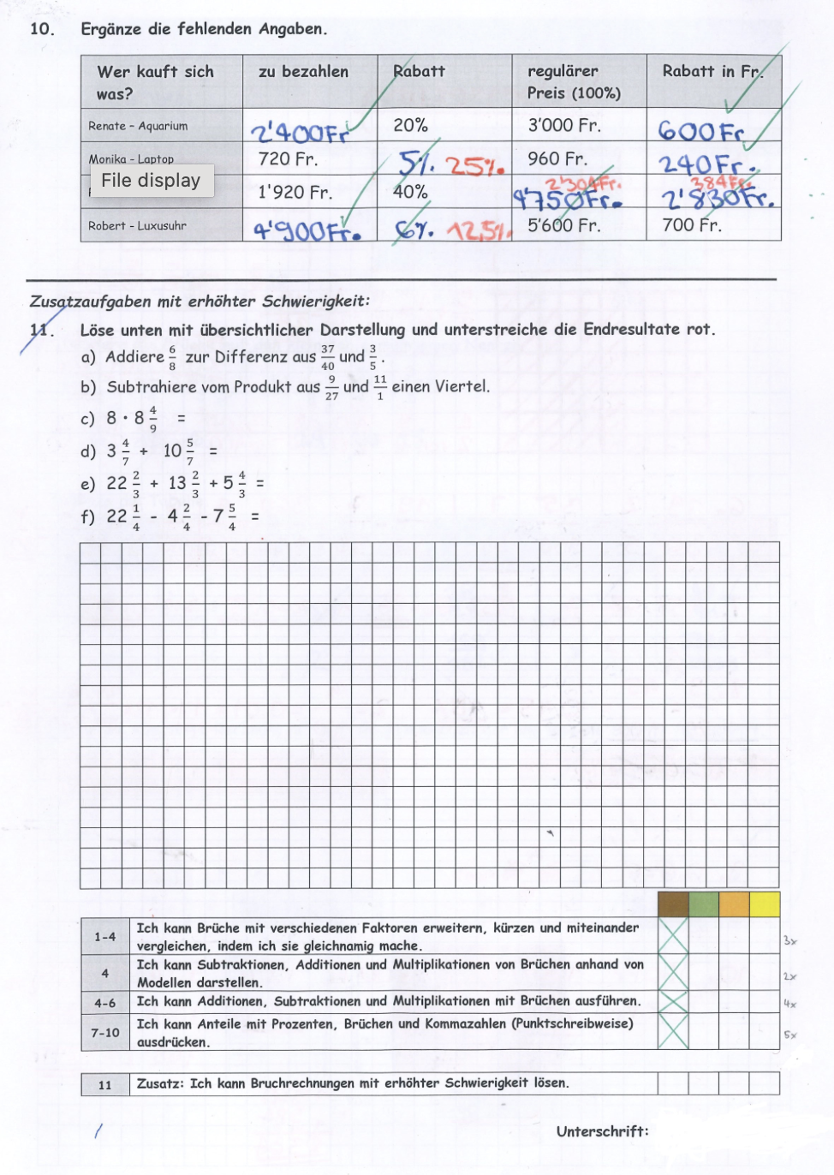
What if teachers could efficiently track individual student progress and identify knowledge gaps?

Slide 12
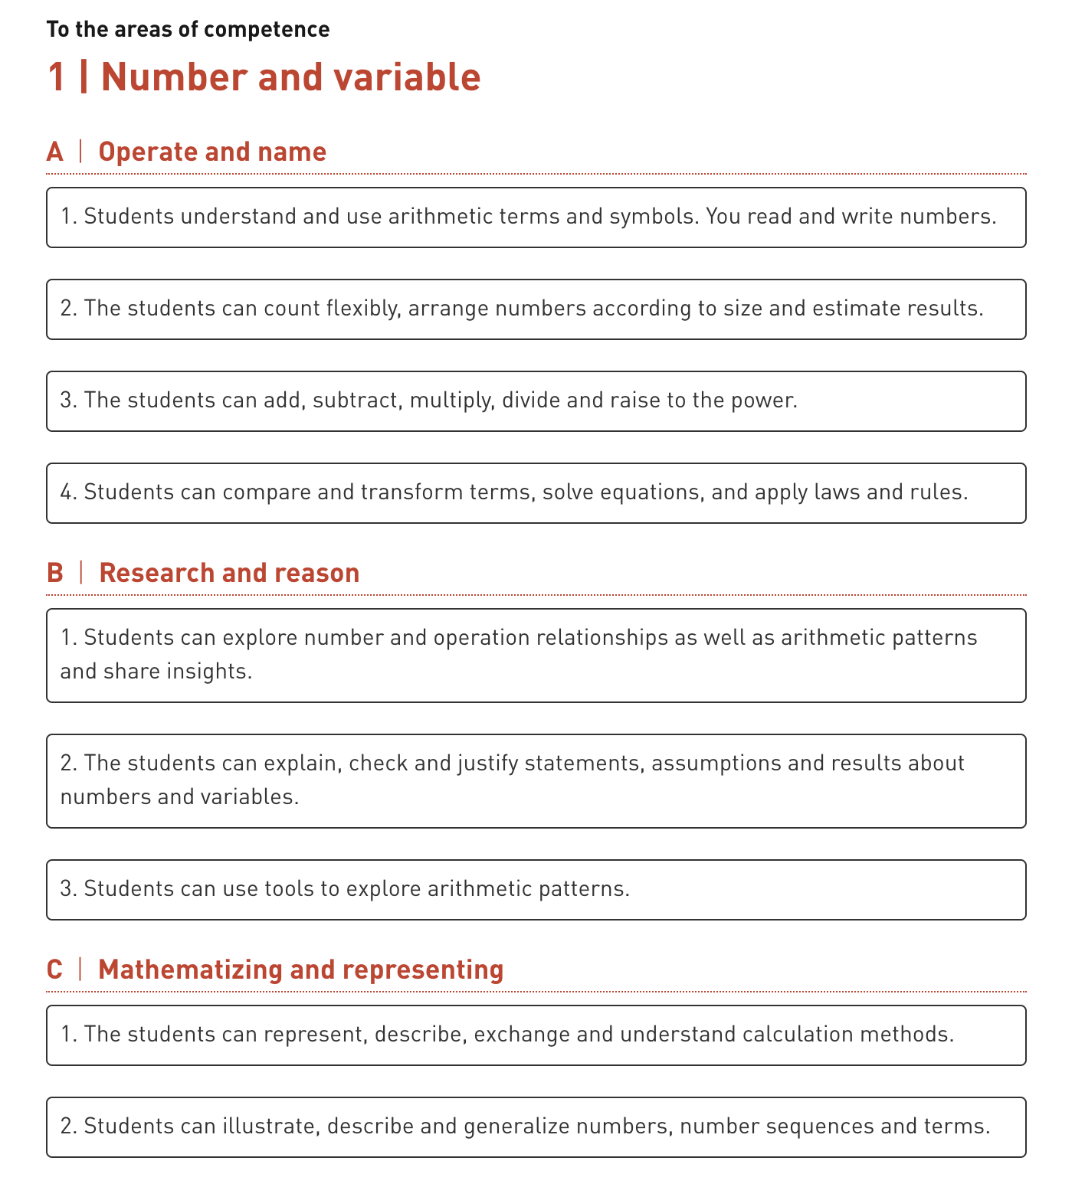
What if teachers could efficiently track individual student progress and identify knowledge gaps?
Curriculum Map
Student Results
+

Slide 13

What if teachers could efficiently track individual student progress and identify knowledge gaps?
LLM

Slide 14
What if teachers could efficiently track individual student progress and identify knowledge gaps?
Personalised
Recommendations
LLM

Slide 15
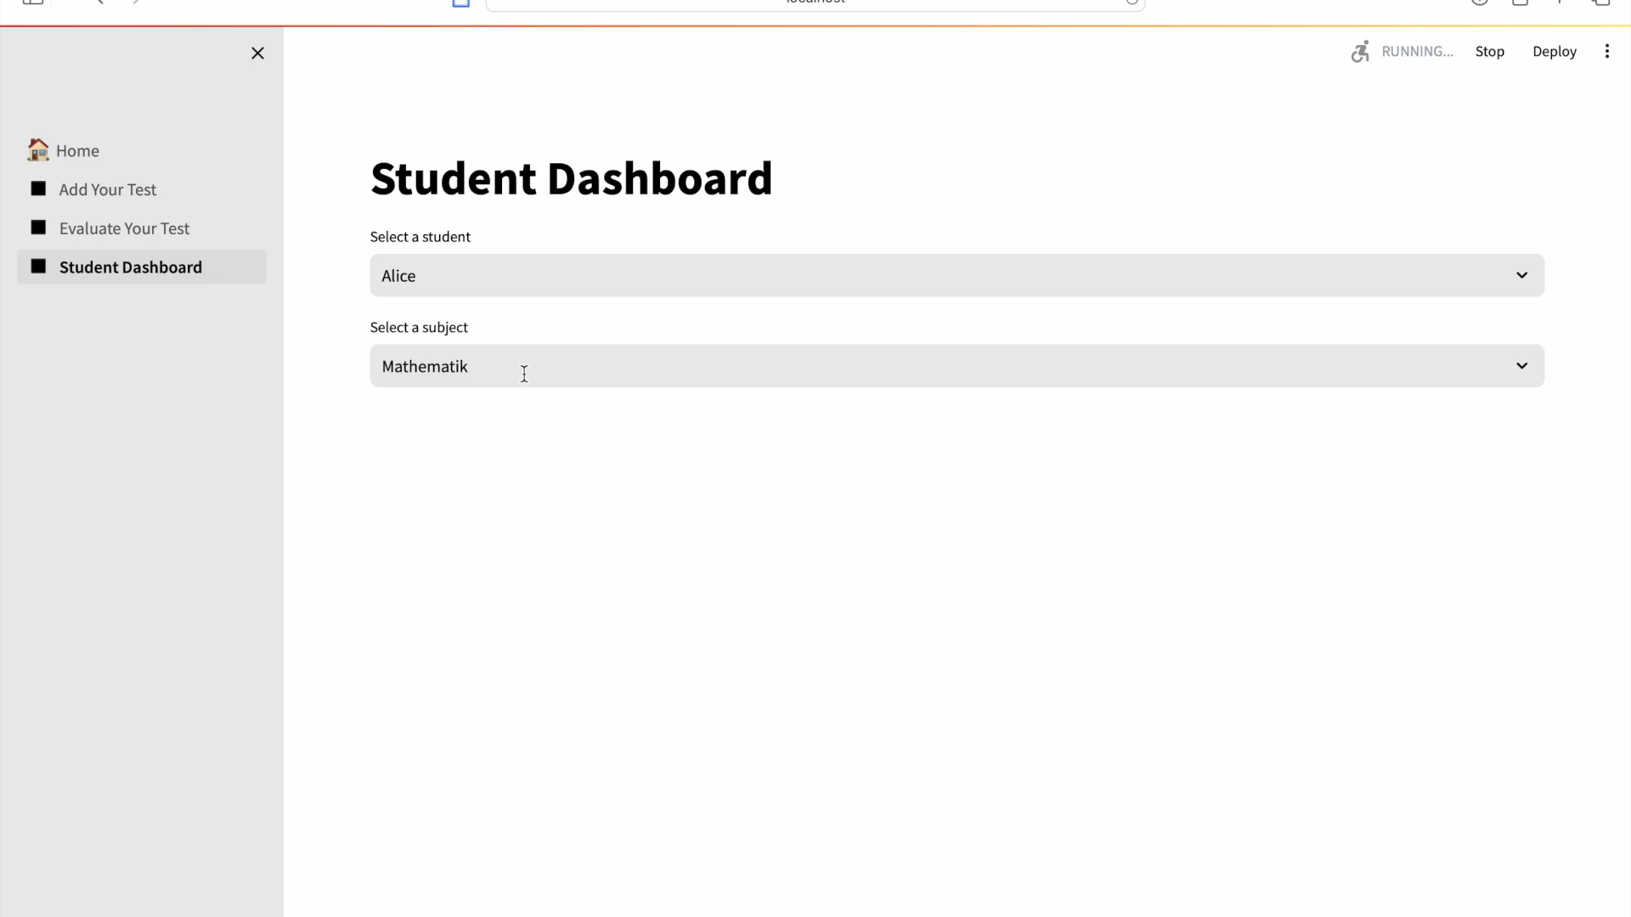

Slide 16
Benefits
Teacher
Parent/Guardian
Student

Slide 17
Thank You

Slide 18
Thank You

Slide 19
Roadmap
Develop Platform
Trial and user feedback
Create marketing campaign
Pitch to different cantons
Reinvest and expand

Slide 20
Competitor Analysis
CSR Initiative
Subsidised Electricity
Infrastructure for the Future
Tool for Reducing Emissions
Reduced Net Carbon Emissions
While there are many platforms for secondary schools and universities, primary schools don’t appear to have effective solutions to track student progress over time and identify knowledge gaps.
DRUID offers a nuanced analysis of student performance, focusing on longitudinal tracking and tailored intervention strategies.

Slide 21
Marketing Campaign
CSR Initiative
Subsidised Electricity
Infrastructure for the Future
Tool for Reducing Emissions
Reduced Net Carbon Emissions
Teacher
Parent/Guardian
Schools

Slide 22
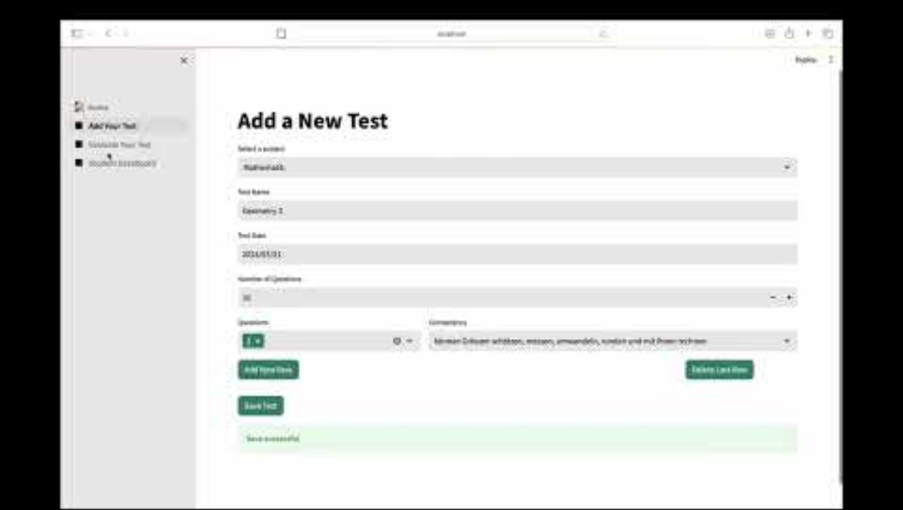
Full Demo
CSR Initiative
Subsidised Electricity
Infrastructure for the Future
Tool for Reducing Emissions
Reduced Net Carbon Emissions
CSR
Subsidised Electricity
Infrastructure for the Future

